Slide 1
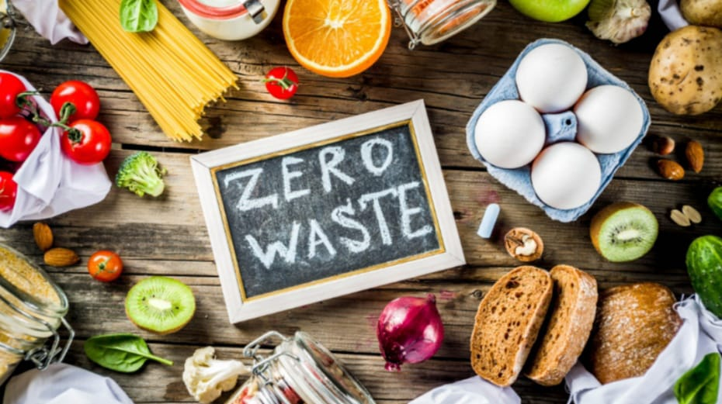
FOOD 4ALL
American Allegiance of Education hackathon

Slide 2
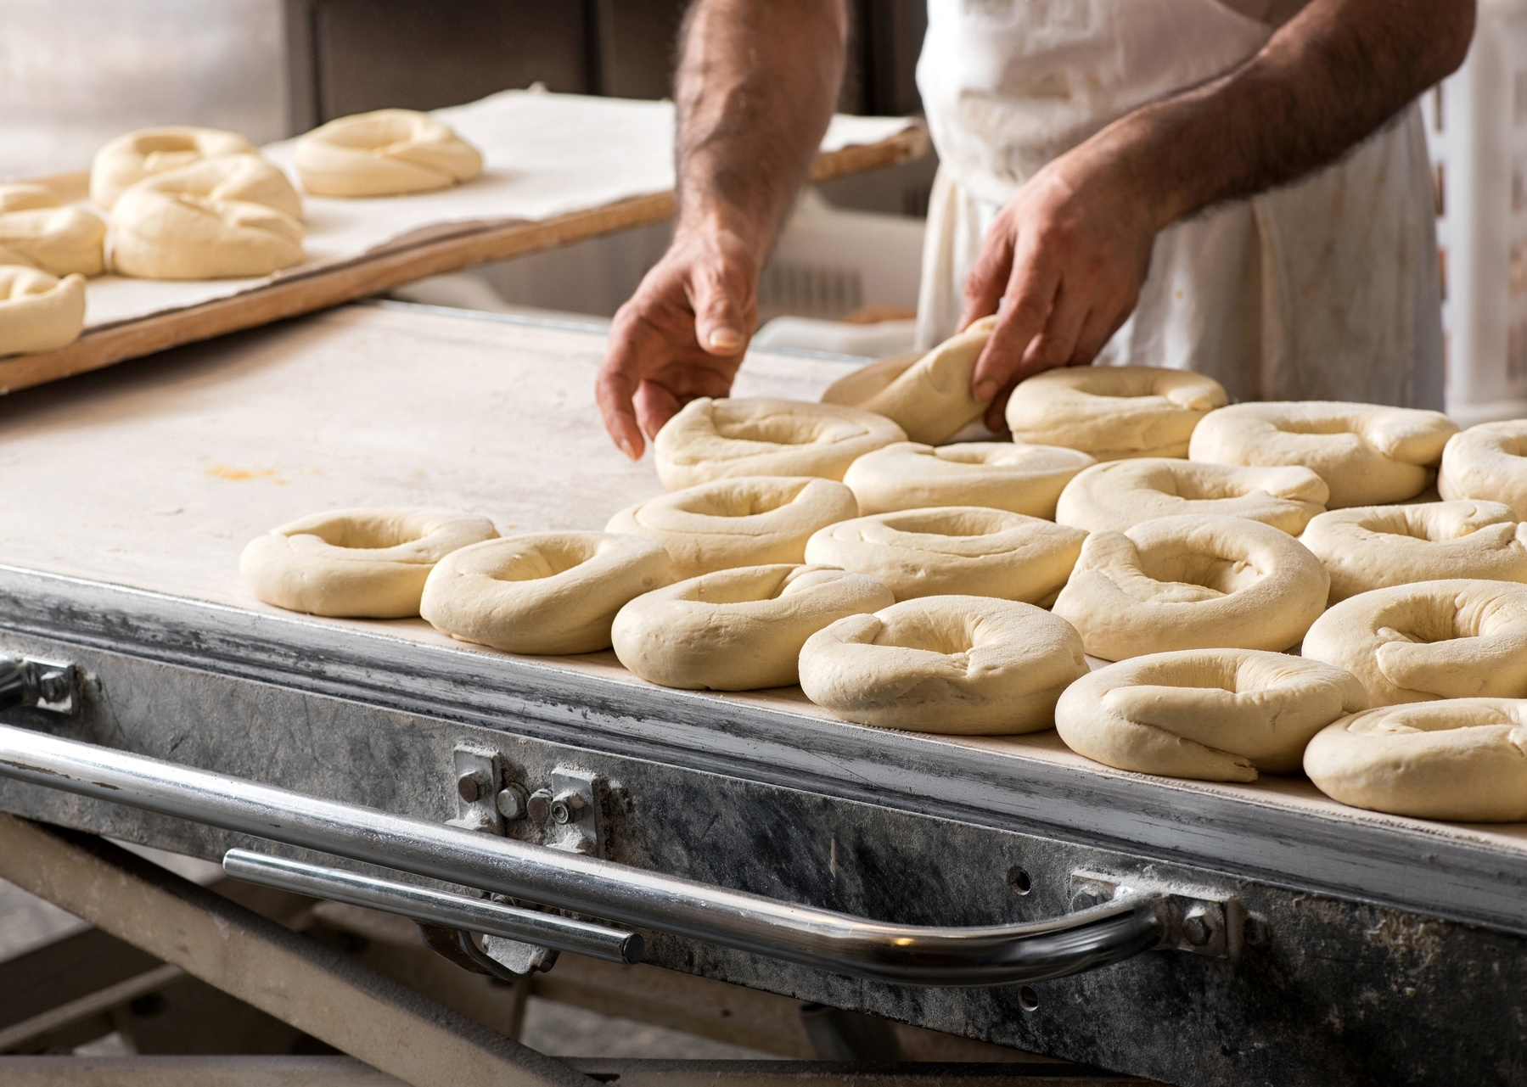
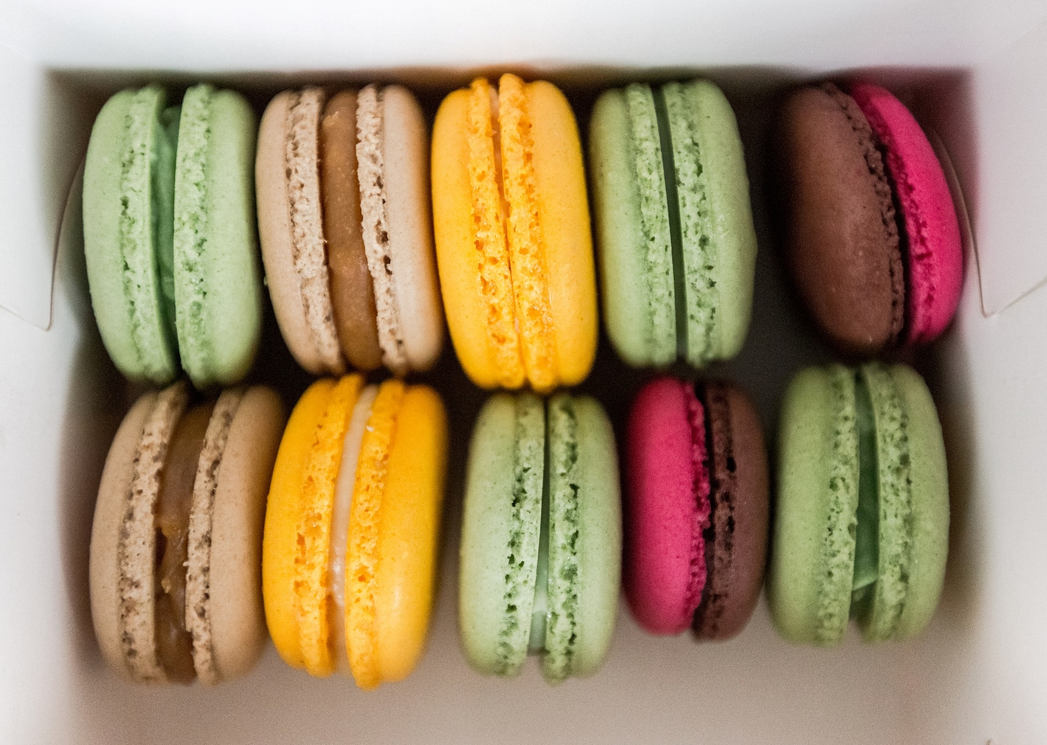
Introduction
Problem: Restaurants struggle with food waste due to inaccurate predictions of how much to produce.
Solution: We developed an algorithm that forecasts food orders for the next 10 weeks.
Goal: Help restaurants produce just the right amount, reducing waste and saving money.
Impact: This approach leads to better inventory management and a more sustainable operation.
Future Vision: We aim to expand this solution to more restaurants and continuously improve the accuracy of the predictions.

Slide 3
Food Waste!

Slide 4
SOLUTION
Algorithm Development: Created a predictive algorithm to forecast food orders for the next 10 weeks.
Data Analysis: Uses historical data to identify patterns in customer demand.
Accurate Predictions: Provides restaurants with precise order estimates to match production.
Easy Integration: Can be smoothly incorporated into restaurant operations.
Real-time Updates: Continuously refines predictions as new data becomes available.

Slide 5

DEMO VIDEO!

